Slide 1
GRIEVANCE MANAGEMENT SYSTEM
Nandana S
S Sagar Krishna
Vivek Narayanan

Slide 2
INTRODUCTION
Developing a Grievance Management System to streamline grievance handling.
Supports three roles: User, Supervisor, and Assignee.
Users submit grievances and track status updates.
Supervisors categorize and assign grievances.
Assignees resolve grievances and update statuses.
Built with React.js (frontend), Spring Boot and Java (backend), and PostgreSQL (database).
Enhances response times, accountability, and user satisfaction.

Slide 3
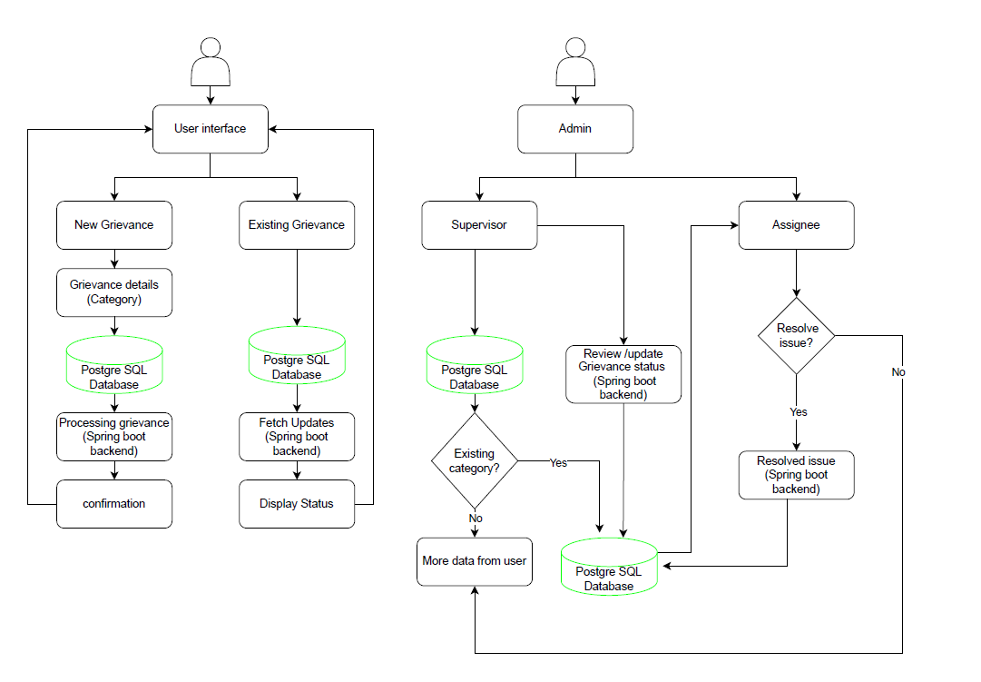
ARCHITECTURE

Slide 4
PROPOSED METHOD
User Role :
1.Raise Grievances : Submit complaints or queries through a user-friendly interface.
2.View Status : Track the status and receive updates on submitted grievances.
Supervisor Role:
1. Review and Categorize : Access, review, and categorize grievances submitted by users.
2. Assign Tasks: : Assign grievances to appropriate assignees and monitor their progress.

Slide 5
Assignee Role:
1.Receive Assignments : Get notifications for and access newly assigned grievances.
2.Resolve and Update : Work on resolving grievances and update the status into system

Slide 6
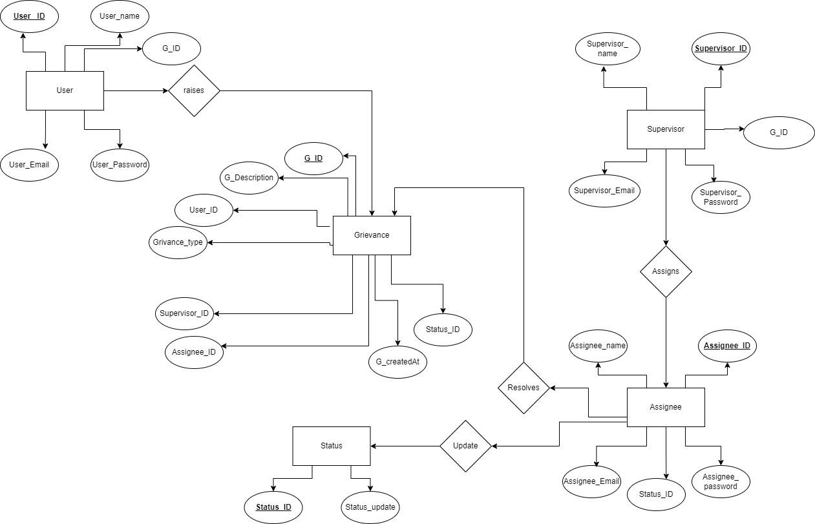
ER DIAGRAM

Slide 7
THANK YOU

